Slide 1
Imodels Update
09-01-20

Slide 2
Figure 2
a-1).
b-1).
c-1).
a-2).
b-2).
c-2).
a-3).
b-3).
c-3).
1
1
1
2
2
2
3
3
3
a-4).
b-4).
c-4).

Slide 3
a-1).
b-1).
c-1).
a-2).
b-2).
c-2).
a-3).
b-3).
c-3).
1
1
1
2
2
2
3
3
3
a-4).
b-4).
c-4).

Slide 4
Figure 3
Figure 4
Pearson Correlation Coefficient

Slide 5
Figure 5
Black-dispersed
purple- stringy
red- aggregated
Normalized Phase
SASA
FSA
Asphericity
Radius of Gyration

Slide 8
Redo Figure 2 RDF

Slide 9
Comparison to Pangiotopolous

Slide 10
N = 18 Carbons
ρ= 3.5 CH/nm²
FSA = 0.55
Dispersed
Dispersed
Dispersed
Chain Density (CH/nm²)
Chainlength (carbons)
Chainlength (carbons)
Stringy
Solvent Accessible Surface Area
Stringy
Stringy
Aggregated
Aggregated
a).
Fractional Surface Area
b).
Fractional Surface Area
c).
Chain Density (CH/nm²)

Slide 11

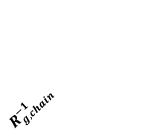
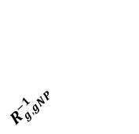

Coordination Std
$$R_{g,chain}^{−1}$$
Coordination Number
FSA
$$R_{g,gNP}^{−1}$$
Predicted Phase
Chain Length
Asphericity
Chain Density
fSASA
Predicted Phase
Coordination Number
Coordination Std
Chain Length
Chain Density
Absolute Spearman Correlation Coefficient
FSA
fSASA
$R_{g,chain}^{−1}$
$R_{g,gNP}^{−1}$
Asphericity

Slide 12


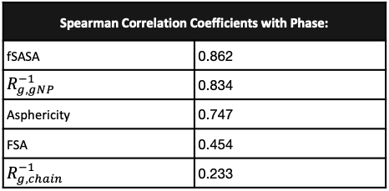
a).
b).
c).
Normalized Phase
fSASA
FSA
Asphericity
d).
e).
Phase
Dispersed Stringy Aggregated
Spearman Correlation Coefficients with Phase:
fSASA | 0.862
$R_{g,gNP}^{−1}$ | 0.834
Asphericity | 0.747
FSA | 0.454
$R_{g,chain}^{−1}$ | 0.233
Normalized Phase
$$R_{g,gNP}^{−1}$$
$$R_{g,chain}^{−1}$$

